Slide 1
Shallow neural nets
logistic regression as a net, multi-category classification, gradient descent, forward and back prop, PyTorch tutorial

Slide 2
Logistic regression as a net
and network notation

Slide 3
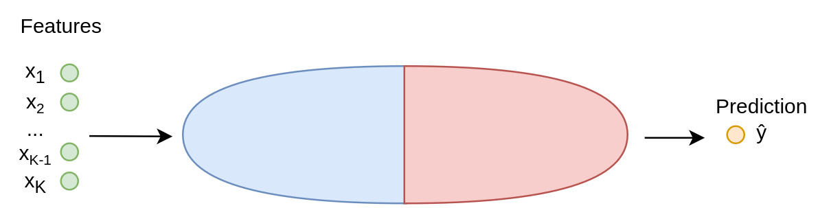

Slide 4
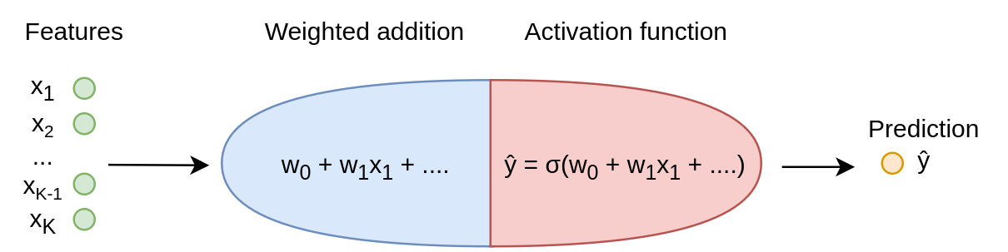

Slide 7
Logistic regression as a net
We said that logistic regression is:
ŷ = σ( w₀ + w₁x₁ + w₂x₂ + ... + w_{K}x_{K})
where σ is the logistic (or inverse logit) function
Network notation:
z = w₀ + w₁x₁ + w₂x₂ + ... + w_{K}x_{K}
ŷ = a = σ(z)
Notes:
Z is a weighted addition, a.k.a. a linear combination, of all the features. a stands for activation; it is what you get after you put z through a so-called activation function. Activation is the final value of a node in a neural net, which it passes on to the next layer. You can imagine it as: how much do the combinations of the features and their weights make the node "light up"? In the case of logistic regression though, there is only one node

Slide 8
Logistic regression as a net
Logistic regression has one node with several weights w₀, w₁, …, w_{K}
Alternative notation:
w = [w₀, w₁, …, w_{K}]
x = [1, x₁, …, x_{K}]
w^{T}x = w₀ + w₁x₁ + w₂x₂ + ... + w_{K}x_{K}
w₀ is sometimes also called b for "bias"
Notes:
This is a dot product; have we seen this before? It assumes that every data point's list of features start with a feature x0 that is just 1 for everyone
This is not the same bias as in the bias-variance tradeoff; it's a value that shows whether the node gets activated even if it receives all-zero inputs, so if all features were zero. If it's negative, then the node will have negative activation unless the sum of the features make up for is

Slide 9
Logistic regression as a net
To train (fit) this model, we need a loss function ℓ(ŷ, y) to minimize
For logistic regression usually log loss, a.k.a. cross-entropy:
ℓ(ŷ, y) = − ( y log(ŷ) + (1−y) log(1−ŷ) )
punishing us strongly for confident wrong guesses

Slide 10
Logistic regression as a net
https://playground.tensorflow.org/
Notes:
We'll talk in a minute about

Slide 11
Multi-category classification

Slide 12
Multi-category classification
Logistic regression is for binary classification
What if we have several categories?
Product reviews: positive, negative or neutral
Tweet emotion: happy, angry, sad, surprised, afraid
Next word in sentence: A, Aardvark, About…
Equivalent for multi-class: softmax (or multinomial logistic regression)
Notes:
Q, small groups: what's another example of multi-category classification?

Slide 13
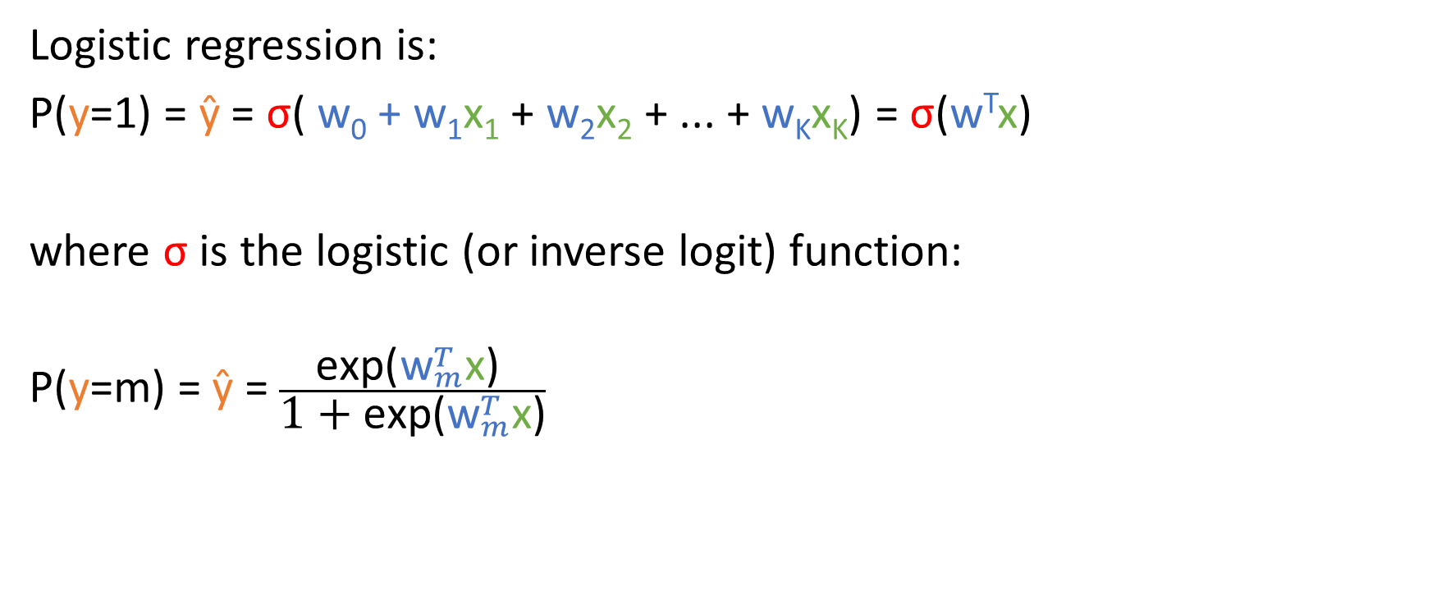
Multi-category classification
Logistic regression is:
P(y=1) = ŷ = σ( w₀ + w₁x₁ + w₂x₂ + ... + w_{K}x_{K}) = σ(w^{T}x)
where σ is the logistic (or inverse logit) function:
$$\text{P}\text{(}\text{y}\text{=}\text{m}\text{) = }\text{ŷ }\text{= }\frac{\text{exp}\text{(}{\text{w}}_{m}^{T}\text{x}\text{) }}{\text{1 + }\text{exp}\text{(}{\text{w}}_{m}^{T}\text{x}\text{)}}$$
Notes:
This transformation of the linear portion makes sure that it is squeezed between 0 and 1

Slide 14
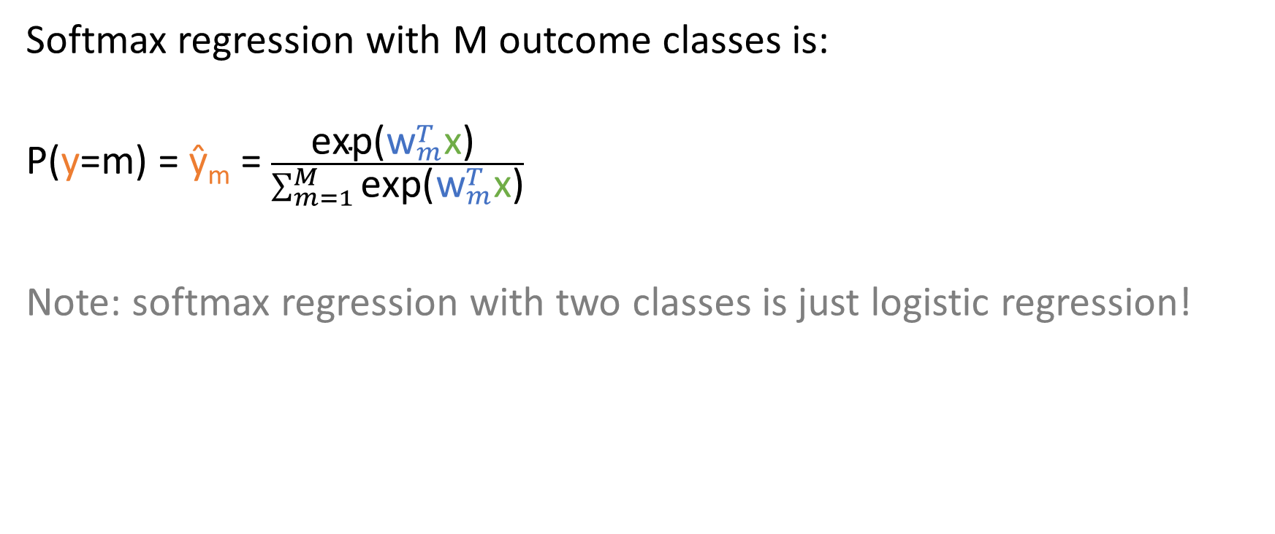
Multi-category classification
Softmax regression with M outcome classes is:
$$\text{P}\text{(}\text{y}\text{=}\text{m}\text{) = }\text{ŷ}\text{m} \text{= }\frac{\text{exp}\text{(}{\text{w}}_{m}^{T}\text{x}\text{) }}{\sum_{m=1}^{M}{\text{exp}\text{(}{\text{w}}_{m}^{T}\text{x}}\text{)}}$$
Note: softmax regression with two classes is just logistic regression!
Notes:
M outcome classes: so in a model for predicting whether a review is negative, neutral or positive, M is 3. In a model for predicting what is the next word in a sentence, M is equal to the size of the vocabulary. Division by the sum of the exponentials for all of the classes: this means that not only is the probability for each class squeezed into the range between 0 and 1, we also make sure that the probabilities across all the classes sum to one. (show boardwork: if you have quantities a, b and c, then if you normalize them by a+b+c, they will sum to one)

Slide 15
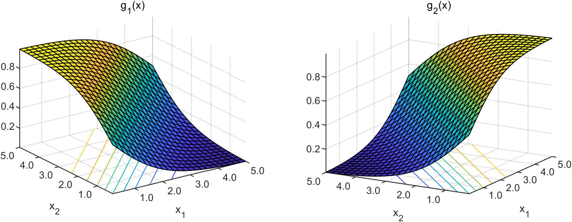
Notes:
Now, every class will have its own S-shape, so the probability of getting every class will have an S-shaped relationship with the features

Slide 16
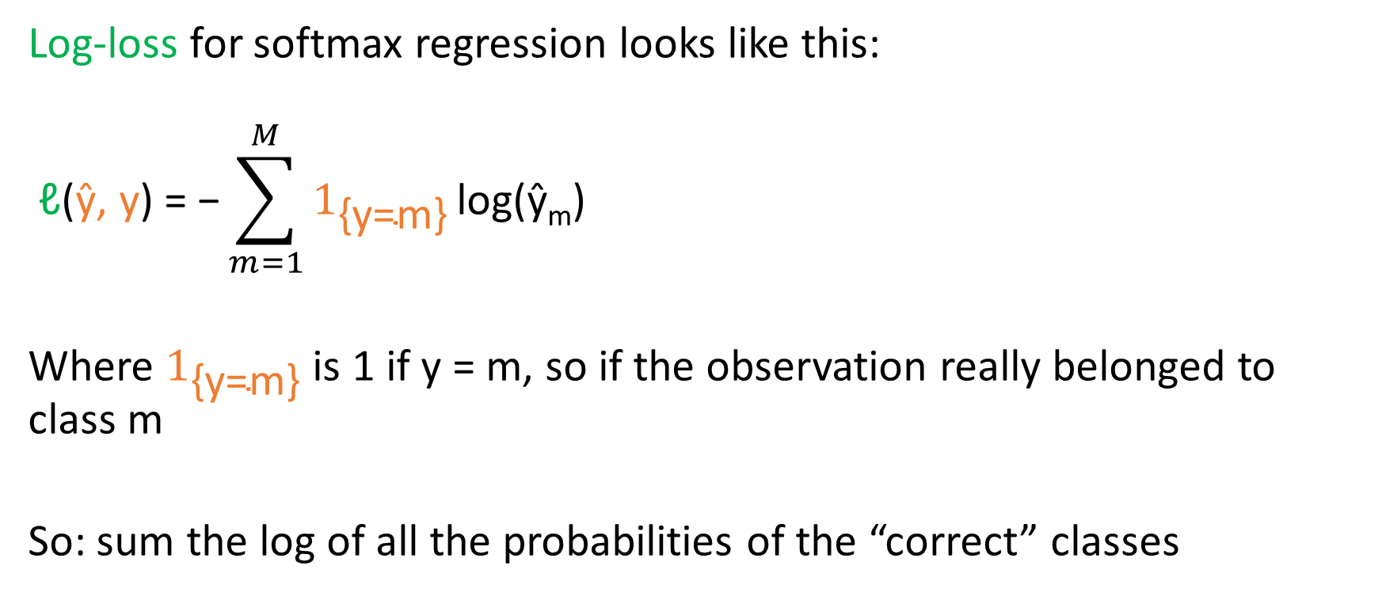
Multi-category classification
Log-loss for softmax regression looks like this:
$$\text{ℓ}\text{(}\text{ŷ, }\text{y}\text{) = −}\sum_{m=1}^{M}{1_{\text{\{}\text{y}\text{=}\text{m}\text{\}}} \text{l}\text{og}\text{(ŷ}\text{m}\text{)}}$$
Where $1_{\text{\{}\text{y}\text{=}\text{m}\text{\}}}$ is 1 if y = m, so if the observation really belonged to class m
So: sum the log of all the probabilities of the “correct” classes
Notes:
So, if we gave a probability of .80 to the next word in the sentence being “dog”, and we know that the next word actually was “dog”, then for that data point we add .8 to the summation. Boardwork: show this for several sentences, showing how the negative sum gets larger as we give higher probs to the correct words.

Slide 17
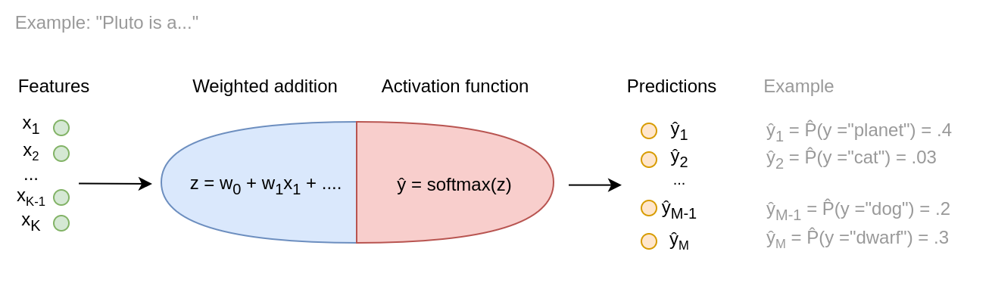
Notes:
Neural net with softmax layer

Slide 18
Notes:
Neural net with softmax layer

Slide 19
Gradient descent

Slide 20
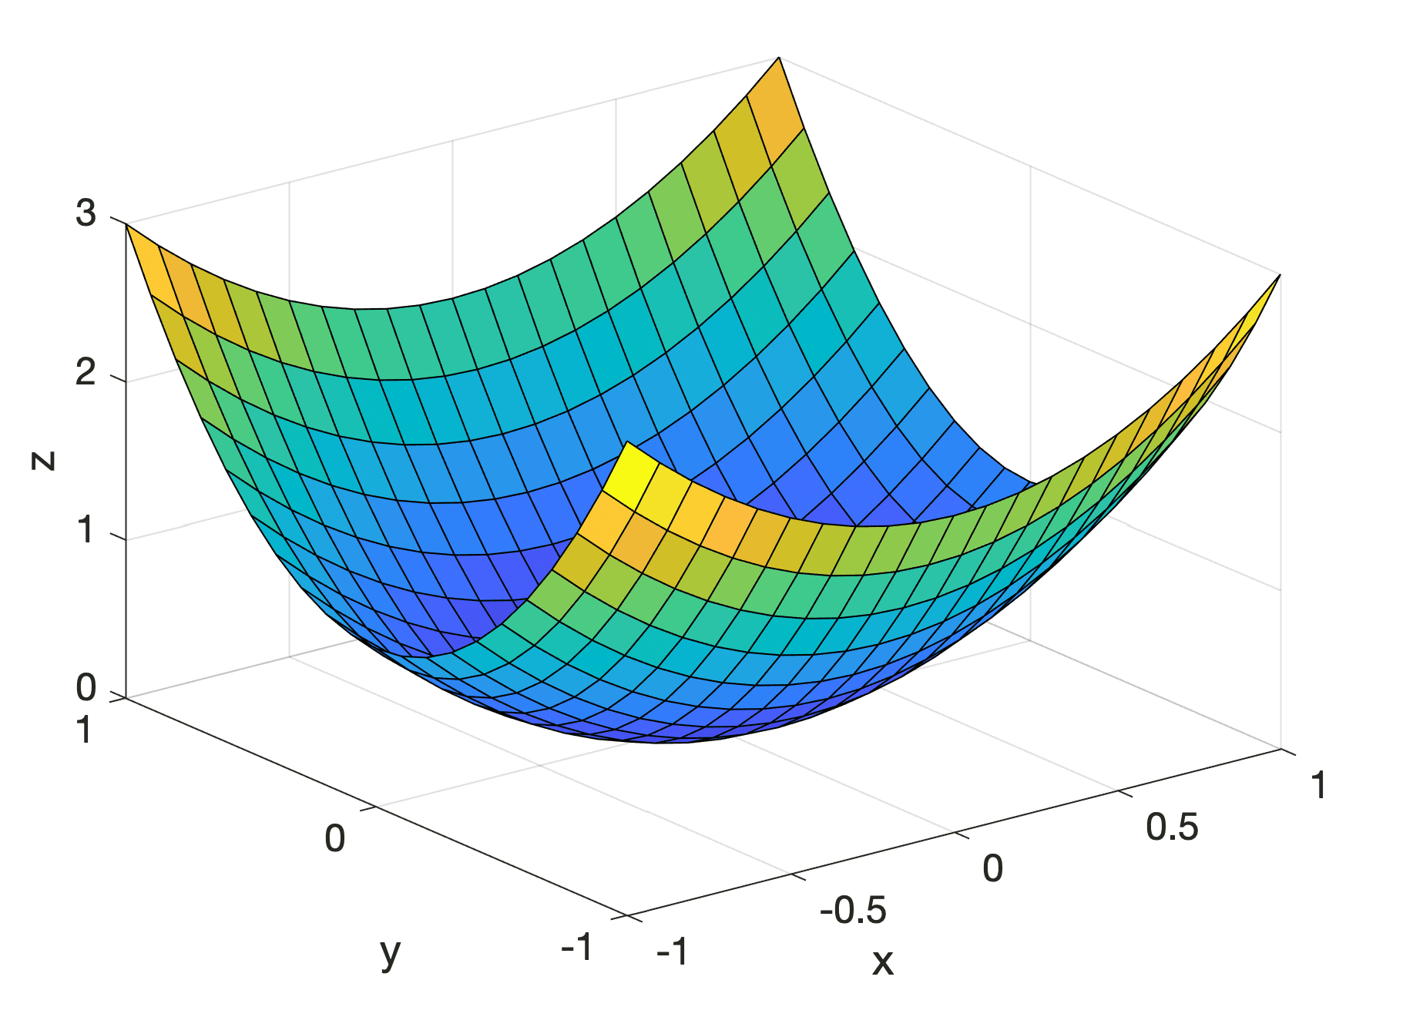
Gradient descent
What values of w₁, …, w_{K} minimize the loss function ℓ(ŷ, y)?
In OLS and logistic regression (with log loss):
closed-form solutions
With more complicated neural nets:
no known solution
ℓ
w₁
w₂
Notes:
Note that we've been writing the loss function as a function of ŷ and y, but (1) ŷ is of course a function of the w's, because the w's when we are fitting (a.k.a. training) the model, y
Closed-form = you can write down the formula. You only have to calculate it.

Slide 21
Gradient descent
What values of w₁, …, w_{K} minimize the loss function ℓ(ŷ, y)?
Wait, is ℓ(ŷ, y) a function of w₁, …, w_{K}?
Yes, of course, because:
ŷ = f(x₁...x_{K}, w)
Notes:
In fact, given our training data, the y's and x's are constant. So when we are training the model, the things that vary are the parameters, the weights, the w's.

Slide 22
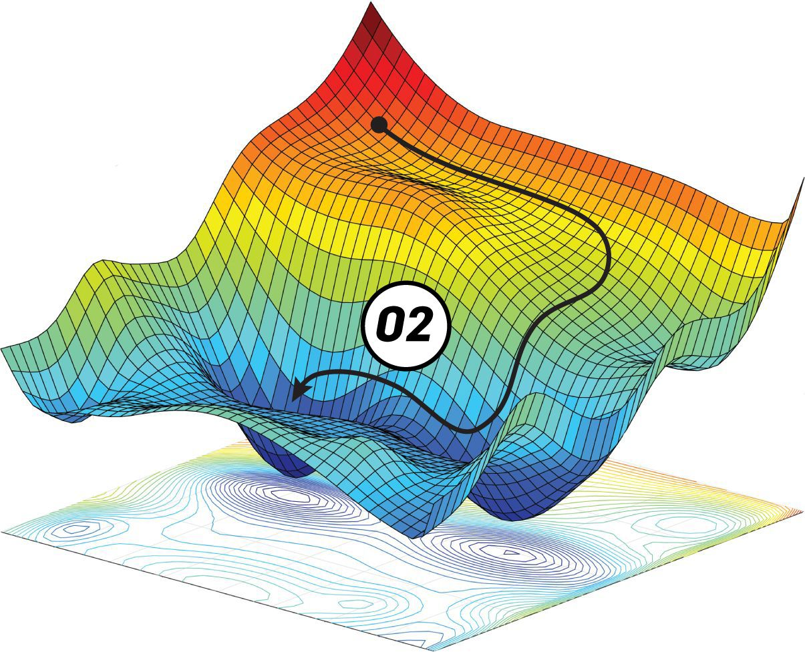
Notes:
The point is, we don't see this graph. Often, we can't calculate this graph because we don't have the formulas for it. So instead, imagine that we are wandering around this plane with our eyes closed, only feeling one thing: which way is down from where we are

Slide 23
Gradient descent
What values of w₁, …, w_{K} minimize the loss function ℓ(ŷ, y)?
Algorithmic solution: gradient descent
Start somewhere
Find the direction in which the function goes down fastest
Take a step in that direction (faster descent = bigger step)
Repeat

Slide 24
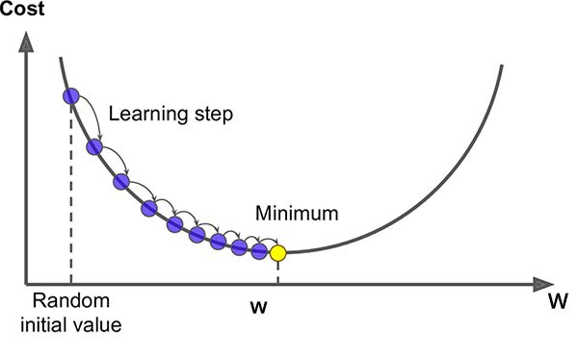
Notes:
We start at random on the top left. Which direction should we go? To the right—that's pretty simple. But remember, the steepness of the curve also tells us how big of a step we should take. So at first, we can see that descent is quite steep, so we take a big step to the right. As we get closer to the bottom, the curve becomes less steep, so we start to take smaller steps. We keep going until the curve is so flat that it would mean taking an almost imperceptible step. That's when we conclude we have found the approximate minimum.
https://saugatbhattarai.com.np/what-is-gradient-descent-in-machine-learning/

Slide 25
a
w₂
w₁
Notes:
https://blog.paperspace.com/intro-to-optimization-in-deep-learning-gradient-descent/

Slide 26
Gradient descent
Now with math!
1. Start somewhere
random or all w_{k} = 0 or based on previous model iterations or…

Slide 27
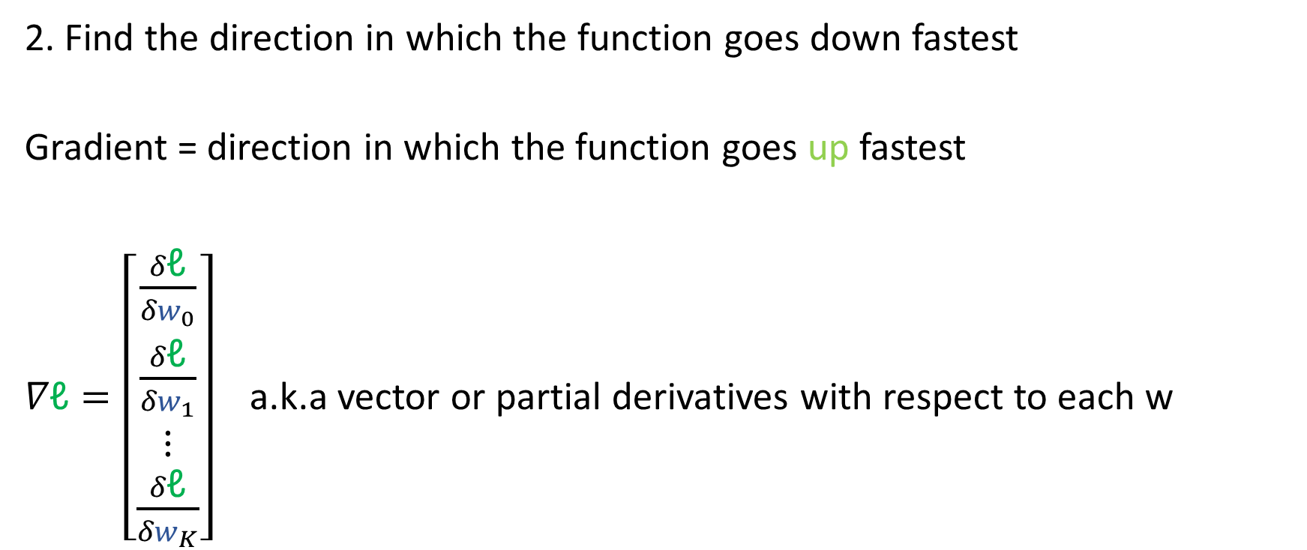
Gradient descent
2. Find the direction in which the function goes down fastest
Gradient = direction in which the function goes up fastest
$∇\text{ℓ}=\left[\begin{matrix}\frac{δ\text{ℓ}}{{δw}_{0}} \\ \frac{δ\text{ℓ}}{{δw}_{1}} \\ ⋮ \\ \frac{δ\text{ℓ}}{{δw}_{K}}\end{matrix}\right]$ a.k.a vector or partial derivatives with respect to each w

Slide 28
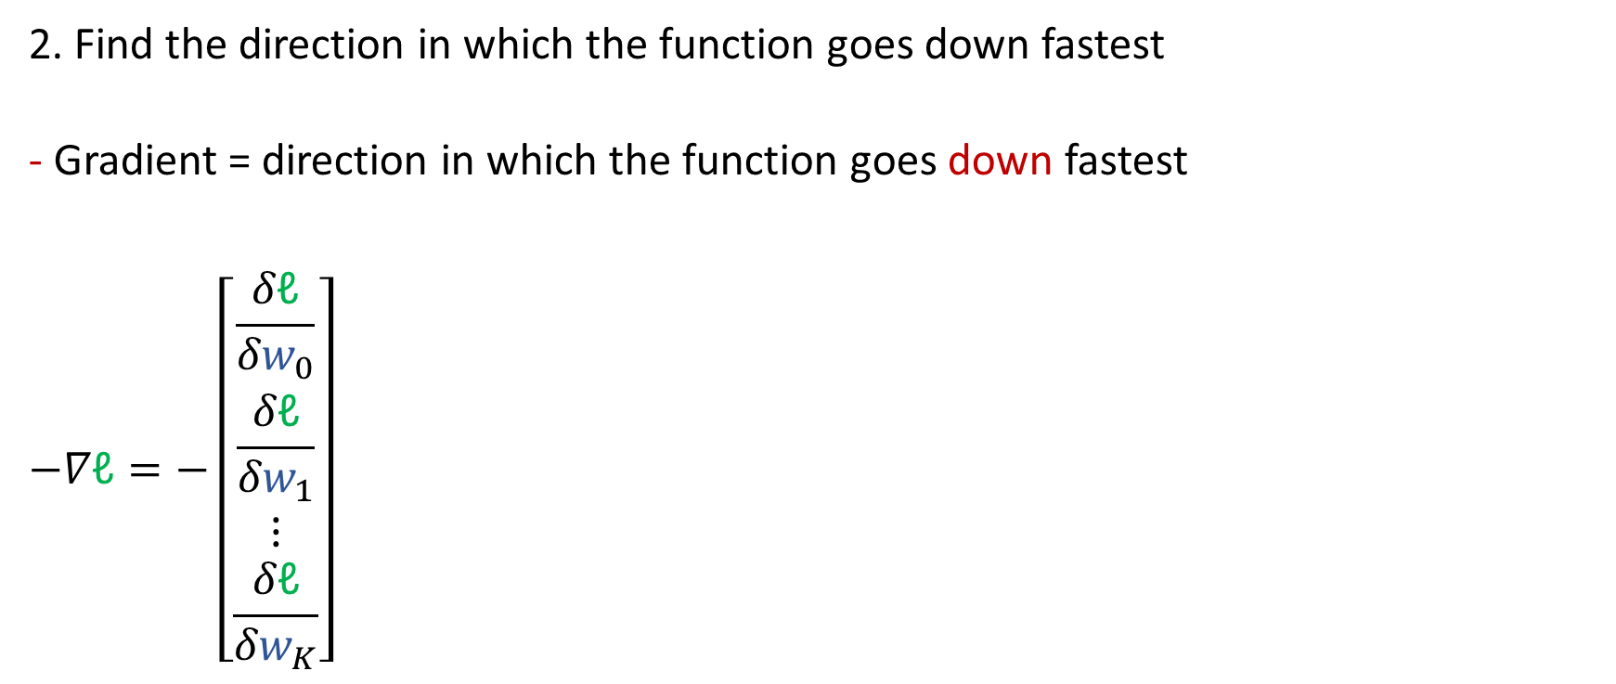
Gradient descent
2. Find the direction in which the function goes down fastest
- Gradient = direction in which the function goes down fastest
$$−∇\text{ℓ}=−\left[\begin{matrix}\frac{δ\text{ℓ}}{{δw}_{0}} \\ \frac{δ\text{ℓ}}{{δw}_{1}} \\ ⋮ \\ \frac{δ\text{ℓ}}{{δw}_{K}}\end{matrix}\right]$$

Slide 29
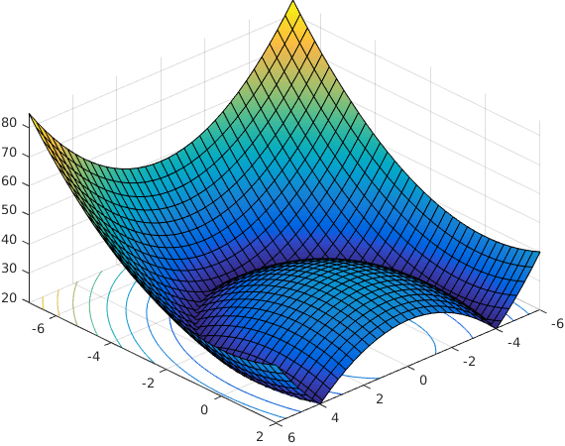
w₁
w₂
Notes:
Let's go into a bit more detail about why minus the gradient is the direction of fastest descent. First of all, a partial derivative is the speed which a function is going up or down *in the direction of one of the input dimensions*, in this case in the direction of one of the weights w1, w2 and so on. The easiest way to think of a partial derivative is to think what it would look like when evaluated at a particular point, at particular values of the w's. So in this case, the partial derivative of this loss function in the direction of w1 at this red point would be quite big and negative (function is going steeply down), which I'm showing by way of a long arrow. The partial derivative with respect to w2 is a lot smaller (function is going slowly down), which I am showing by drawing a short arrow.
https://www.researchgate.net/figure/A-non-convex-function-with-connected-sublevel-sets_fig1_330553337

Slide 30

$$∇\text{ℓ}=\left[\begin{matrix}\frac{δ\text{ℓ}}{{δw}_{0}} \\ \frac{δ\text{ℓ}}{{δw}_{1}} \\ ⋮ \\ \frac{δ\text{ℓ}}{{δw}_{K}}\end{matrix}\right]$$
w₁
w₂
Notes:
So all a gradient is, when you evaluate it at a point in the function, is a vector that has large negative values for directions in which the function is going down fast, and small values for directions in which the function isn't changing so much. If we were to combine these arrows, which is what it ultimately means to put all of these partial derivatives together in a vector called the gradient, then we end up with an arrow that points exactly in the direction that we should go if we want to go down as fast as possible. So if we were climbing down this mountain and we wanted to get down asap, we would mostly go in the direction w1, but also a little bit in the direction w2. That's what the negative gradient tells us.

Slide 31
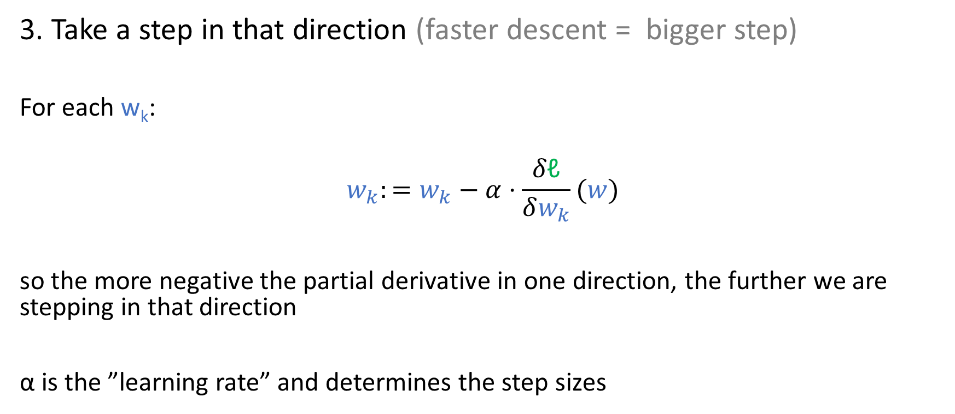
Gradient descent
3. Take a step in that direction (faster descent = bigger step)
For each w_{k}:
$$w_{k}:=w_{k}−α⋅\frac{δ\text{ℓ}}{δw_{k}}(w)$$
so the more negative the partial derivative in one direction, the further we are stepping in that direction
α is the ”learning rate” and determines the step sizes
Notes:
Why is gradient descent easier than calculating the gradient over the whole loss function and finding out where it is zero, which means that the function has reached a peak or valley, giving us a potential candidate for the minimum? Well, here, we are only calculating partial derivative: we are finding out exactly how fast the function is going down or up in *one* direction at a time, seeing *one* w as the variable while holding the values of all the other w's constant. That is a much simpler task,

Slide 32
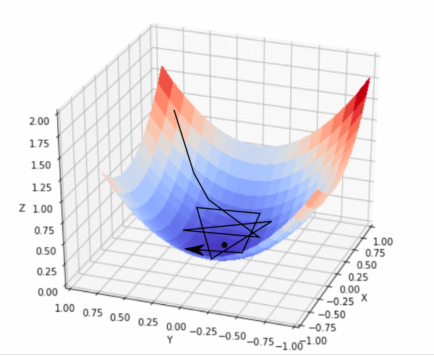
a
w₂
w₁
Notes:
https://blog.paperspace.com/intro-to-optimization-in-deep-learning-gradient-descent/ Too high a learning rate: we keep jumping over the minimum

Slide 33
Gradient descent
4. Repeat
until steps become tiny (“convergence”)
or just a set number of times

Slide 34
Gradient descent
We've been abstracting from the fact that there are many data points
Basic gradient descent:
In each iteration,
average over all data points, i.e. use cost function (avg. of the loss)

Slide 35
Gradient descent
Stochastic gradient descent:
In each interation,
use the loss for one random data point
Mini-batch gradient descent:
In each interation,
use the loss for a small subset of data points
Notes:
Stochastic gradient descent works well because while its overall tendency is still to find minima, it can send the gradient off in a random direction for a little while. That prevents us getting stuck in what's called a local minimum—where the gradient is zero because all surround points have higher loss, but there actually exists another point on the graph that's even further down. Minibatch and stochastic gradient descent also tend to be faster than batch gradient descent, because the gradients (and therefore the steps we take) are noisy, but they are much faster to compute than the gradient on the full data set, and they are good enough approximations of the direction that we really should be going.

Slide 36
Notes:
If we accidentally end up in the local minimum in the right, stochastic gradient descent can help us wander out of it

Slide 37
Forward prop and backprop

Slide 38
Forward prop and backprop
Training a model means alternating "forward" and "backward" propagation (a.k.a. passes)
Forward prop:
calculating activation of the nodes
→ get to ŷ, given the current w's
Notes:
So these are also known as the forward pass and backward pass. Forward prop produces predictions.

Slide 39
Notes:
Forward propagation is simply executing the calculations that you see here. It's using the weights to go from features to predictions.

Slide 40
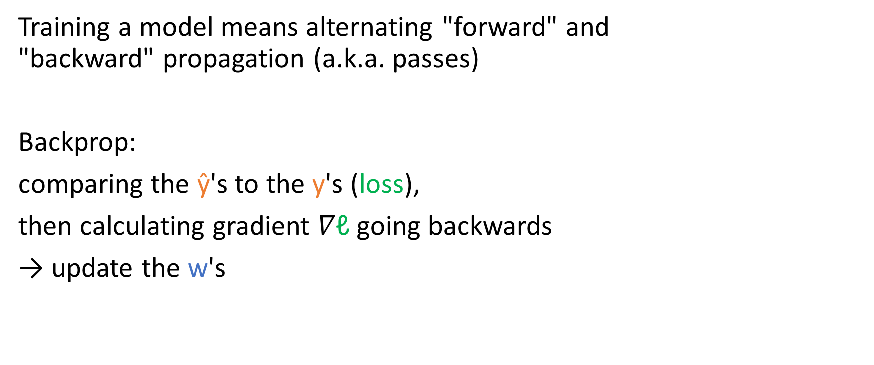
Forward prop and backprop
Training a model means alternating "forward" and "backward" propagation (a.k.a. passes)
Backprop:
comparing the ŷ's to the y's (loss),
then calculating gradient $∇\text{ℓ}$going backwards
→ update the w's
Notes:
Backprop produces parameter estimates.

Slide 41
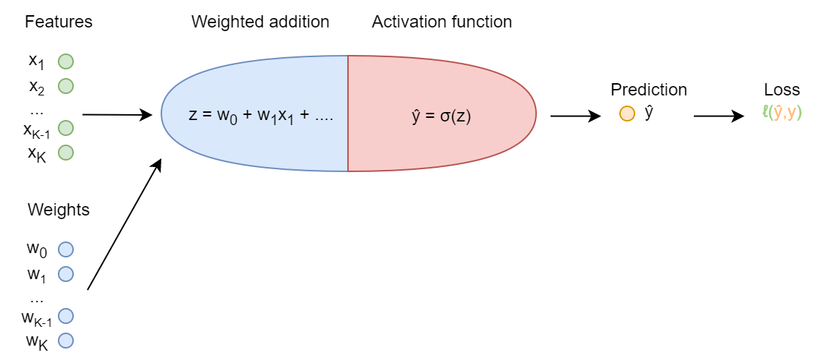
Notes:
Blackboard work: add formulas:
d(l)/d(ŷ) = (-y/ŷ) + (1-y)/(1-ŷ)
d(l)/d(z) = d(l)/d(ŷ) * d(ŷ)/d(z) = d(l)/d(ŷ) * ŷ/(1-ŷ) = z – y
d(l)/d(w1) = d(l)/d(z) * d(z)/d(w1) = d(l)/d(z) * x1 = (z – y) * x1
So, w1:=w1 – α * (z – y) * x1

Slide 42
Next week preview

Slide 43
Deep and sequential neural nets: content
Deep neural nets
Sequential models:
language models (in general)
RNNs
LSTMs

Slide 44
Deep and sequential neural nets: readings
Short sections from Hovy
Two long videos about RNNs and LSTMs
(I picked a different one for RNN! See updated syllabus)
Warmly recommend:
Jurafsky, & Martin, Speech and Language Processing, Chapter 9: RNNs and LSTMs.

